Slide 1



Applied Data Analysis (CS401)
Lecture 8
Learning from data:
Applied machine learning
8 Nov 2023
Robert West
Notes:
2020: 7 min too long; spent 10 minutes on intro including break-ice rooms; 12 min break
2021: 9 min too long; 11 min break
2022: given by Akhil: 9 min too long; 10 min break
2023: 96 minutes; 10-min break; poll skipped (but still discussed)

Slide 2
Announcements
Homework H1
Feedback has been released
Postmortem: recorded video to be released early next week
Project milestone P2 due on Fri 17 Nov 23:59
Friday’s lab session: two parallel tracks:
Quiz 7
Track 1: exercise on applied machine learning (BCH 2201)
Track 2: project office hours (Zoom)
Logistics: see Ed post
Do come and ask for feedback – everyone will win!

Slide 3
Give us feedback on this lecture here: https://go.epfl.ch/ada2023-lec8-feedback
What did you (not) like about this lecture?
What was (not) well explained?
On what would you like more (fewer) details?
…

Slide 4
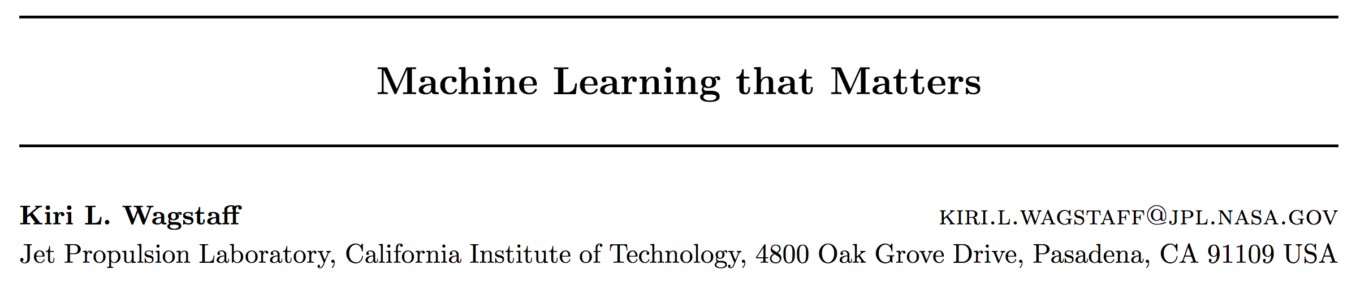
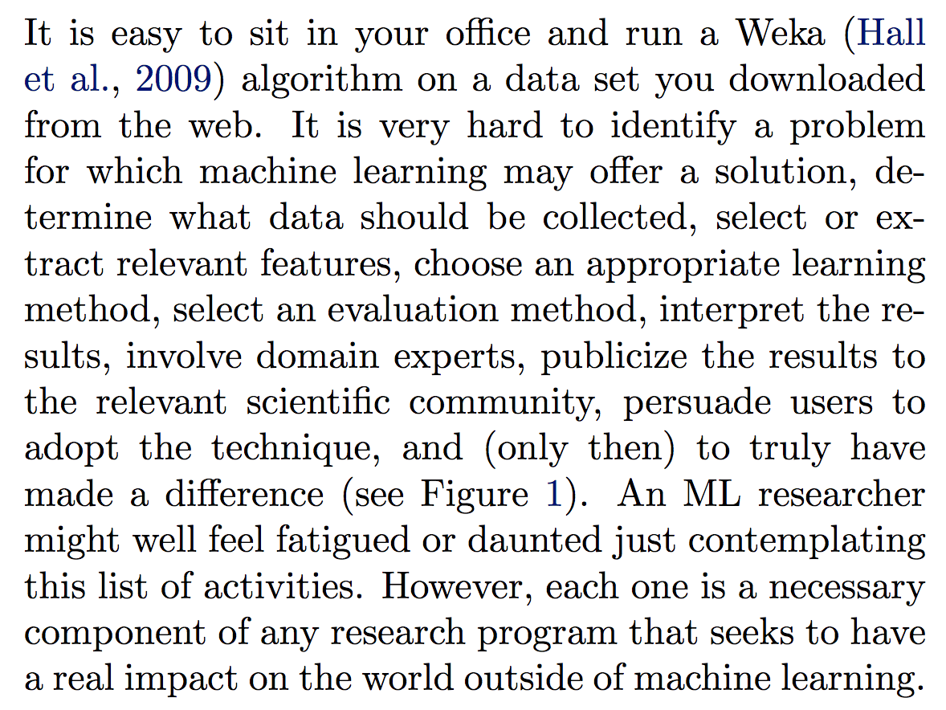
Why an extra class on applied ML?
link
Classic ML
class
ADA

Slide 5
Classification pipeline
Data collection
Model selection
Model assessment
Notes:
We will stick to supervised learning (classification) today
Unsupervised: next lecture
Model selection: selecting type of model (k-NN vs. decision tree vs. log reg vs. DNN etc.), choosing hyperparameters (e.g., depth of decision tree), and model training

Slide 6
Data collection
The first step is collecting data related to the classification task.
Definition of the attributes (or features) that describe a data item and the class label.
Domain knowledge is needed.
What if assigning the class label would be too time-consuming or even impossible?
→ Unsupervised methods (e.g., clustering); cf. next lecture!
Notes:
Garbage in, garbage out

Slide 7
Data collection
Data labeling
Discretization?
N
Identification of features
Y
Y
Unsupervised/ supervised discretization
Class label available?
N
Removing irrelevant features
Standardization etc.
Y
Normalization?
N
Notes:
Data from which to extract features:
Given to you
Crawl
Pay people
We don’t cover this here, but what happens after

Slide 8
Features
Different types of features [more]
Continuous (e.g., height, temperature ...)
Ordinal (e.g., “agree”, “don’t care”, “disagree” ...)
Categorical (e.g., country, gender ...)
New features can be generated from simple stats
Feature engineering is considered a form of art, therefore it is often useful to find what other people did for similar problems
Some classifiers require categorical features => discretization
Notes:
“Simple stats”: e.g., predict if user will like a movie: take mean/std/min/max rating of same user over movies of same type
Discrete features required: e.g., simplest form of decision tree (one child branch per class of feature on which we split)

Slide 9
ML before 2012*
(but still very common today)
* Before publication of Krizhevsky et al.’s ImageNet CNN paper
Input data
Cleverly designed features
ML model
Much of the “heavy lifting” in here.
Final performance only as good as the feature set.
Notes:
Around 122K citations… (5 years ago: 16k, 3 years ago: 48k, 2 years ago 72k, 1 year ago 90k); about 80 new citations per day in last year

Slide 10
A typical ML approach after 2012
Deep learning
Input data
Features
Model
Features and model learned together, mutually reinforcing
Notes:
In ADA: “classic” setup
Still extremely useful
DL works especially well when you have data represented as high-dim raw feat vectors

Slide 11
Data collection
Data labeling
Discretization?
N
Identification of features
Y
Y
Unsupervised/ supervised discretization
Class label available?
N
Removing irrelevant features
Standardization etc.
Y
Normalization?
N

Slide 12
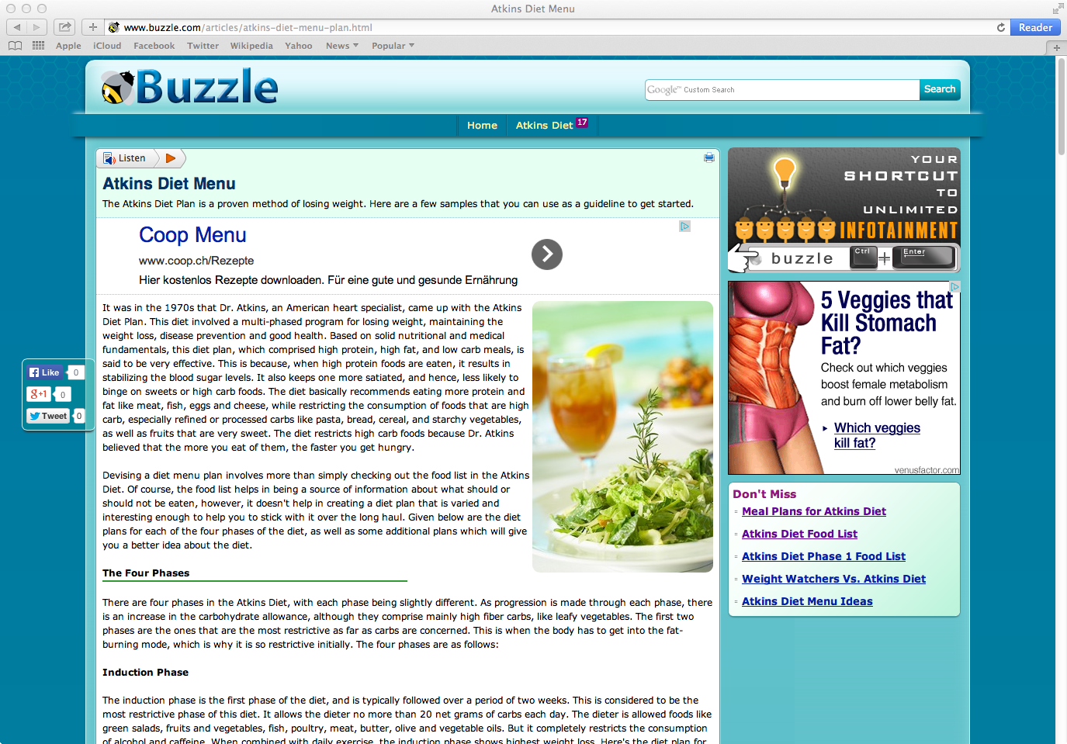
Labels
Collecting a lot of data (features) is often easy.
Labeling data is time consuming, difficult, and sometimes even impossible.
Label: “Is page credible?”
Human dietary expert is needed
Notes:
…
Extracting features may also be hard (e.g., “Is there a food image on the page?”)
Techniques we will see next can also be applied for extracting features

Slide 13
Potential labelers
You
Older days:
Undergraduate students
Domain experts ($$$)
Now: crowdsourcing
Can get both amateurs (~ undergrad students)
and experts
Notes:
“You” not always good option (overfitting to your expectations)
At least don’t reveal features (not always possible)
…
Much of the power of ChatGPT etc. also derives from crowdsourced data

Slide 14




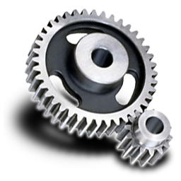


1. Submit task
4. Collect answers
Requester
“Is this webpage
credible?”
Credible
Credible
Not credible
Credible
Not credible
Crowdsourcing
platform
2. Accept task
3. Return answers
Crowd workers
Notes:
…
“Artificial artificial intelligence”

Slide 15
Data collection
Data labeling
Discretization?
N
Identification of features
Y
Y
Unsupervised/ supervised discretization
Class label available?
N
Removing irrelevant features
Standardization etc.
Y
Normalization?
N

Slide 16
Discretization
Why?
Some classifiers want discrete features (e.g., simplest kinds of decision trees)
Discrete features let a linear classifier learn non-linear decision boundaries
Certain feature selection methods require discrete (or even binary) features
Notes:
(Feature selection method requiring discrete labels: mutual information)

Slide 17
Discretization
Unsupervised
Equal width
Divide the range into a predefined number of bins (bad for skewed data, e.g., from a power law)
Equal frequency
Divide the range into a predefined number of bins so that every interval contains the same number of values
Clustering
Notes:
Unsupervised discretisation does not take class information into account.
The obvious weakness of the equal-width method is that in cases where the outcome observations are not distributed evenly, a large amount of important information can be lost after the discretization process
For equal-frequency, many occurrences of a continuous value could cause the occurrences to be assigned into different bins. One improvement can be after continuous values are assigned into bins, boundaries of every pair of neighbouring bins are adjusted so that duplicate values should belong to one bin only.
The advantage of using clustering as discretisation is that it can be performed on all the features at the same time, capturing in this way possible interdependencies of the features.
Sometimes discretisation can even improve the performance of algorithms that do not need discretisation

Slide 18
Discretization
Supervised
Start with very fine-grained discretization
Test the hypothesis that membership in two adjacent intervals of a feature is independent of the class
If they are independent, they should be merged
Otherwise they should remain separate
Independence test: χ² test (“chi-squared test”) [example]
Continue recursively
Notes:
Supervised discretisation takes class information into account, measuring the dependency of a discrete interval of values w.r.t. the class label
If you’re not familiar with chi-squared test: can take it as a black box on this slide

Slide 19
Data collection
Data labeling
Discretization?
N
Identification of features
Y
Y
Unsupervised/ supervised discretization
Class label available?
N
Removing irrelevant features
Standardization etc.
Y
Normalization?
N

Slide 20
Removing irrelevant features: Feature selection
Goal: reduce set of N features to a subset of the best size M < N
Why?
More interpretability
Less danger of overfitting
More efficient training
Problem: There are 2^{N} possible subsets
Solutions:
Filtering as preprocessing (“offline”)
Iterative feature selection (“online”)

Slide 21
Offline feature selection
Rank features according to their individual predictive power; then select the best ones
Pros
Independent of the classifier (performed only once)
Cons
Independent of the classifier (ignore interaction with the classifier)
Assumes features are independent

Slide 22
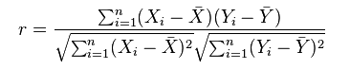
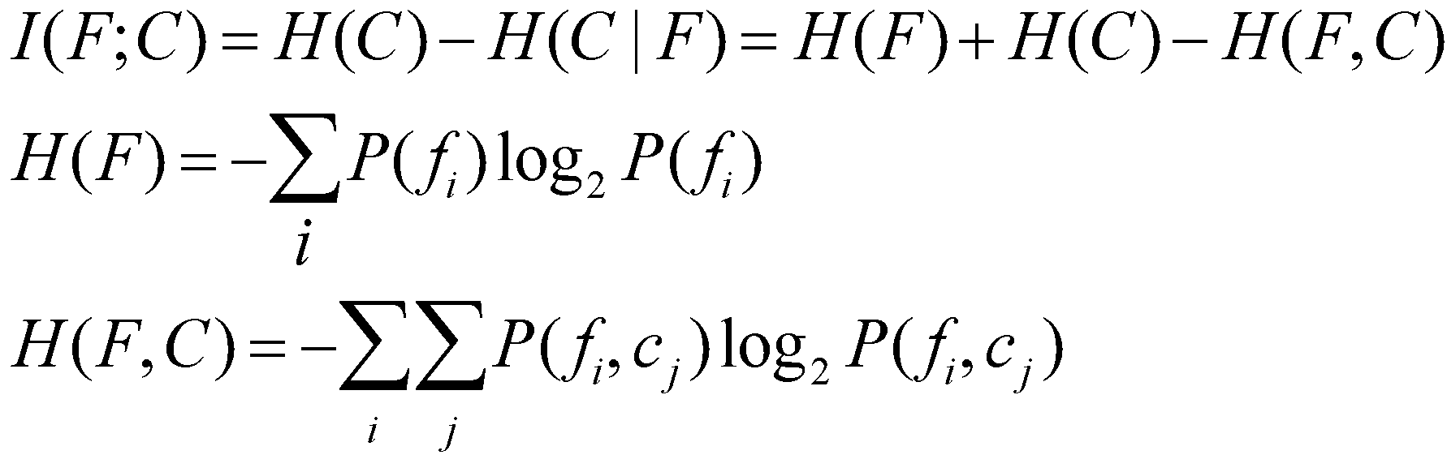
Ranking of features
Continuous features (and ideally labels):
Pearson’s correlation coefficient (capturing strength of linear [!] dependence)
Categorical features and labels:
Mutual information (goes beyond linear dependence)
Notes:
X is a feature and Y is the class label
Using correlation as criteria has some drawbacks. Defining the correlation threshold is subjective (which is a good correlation value? 0.7 is enough?). Also, the Pearson correlation coefficients only captures linear relationships
MI: def just for ref; you of course know it already
Mutual information measures the information that X and Y share: it measures how much knowing one of these variables reduces uncertainty about the other. If I(X,Y) = 0, knowing X does not tell anything about Y, when I(X,Y) is maximal by knowing X we already know Y
MI: a reason for moving to cat vars

Slide 23
Ranking of features
Categorical features and labels (cont’d):
χ² method (“chi-squared”)
Similar to χ² method for feature discretization
Test whether feature is independent of label
Difference w.r.t. mutual information: the χ² test checks the independence of the class and the feature, without indicating the strength or direction of any existing relationship (you just get a significance, a.k.a. p-value)

Slide 24
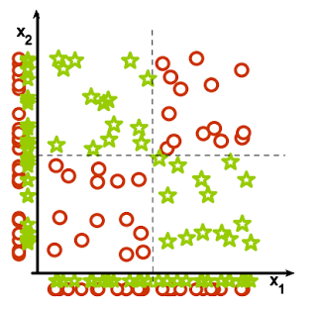
Ranking of features
Beware: collectively relevant features may look individually irrelevant!
Notes:
Green stars: positive examples
Red circles: negative examples
Solution: online methods (p.t.o.)

Slide 25
Online feature selection
Forward feature selection: greedily add features; evaluate on validation dataset; stop when no improvement
Pros
Interact with the classifier
No feature-independence assumption
Cons
Computationally intensive
Notes:
Validation set can’t be used for training!
(or cross-validation, in a few slides)

Slide 26
Online feature selection
Backward selection (a.k.a. ablation): greedily remove features; evaluate on validation dataset; stop when no improvement
Pros
Interact with the classifier
No feature-independence assumption
Cons
Computationally intensive

Slide 27

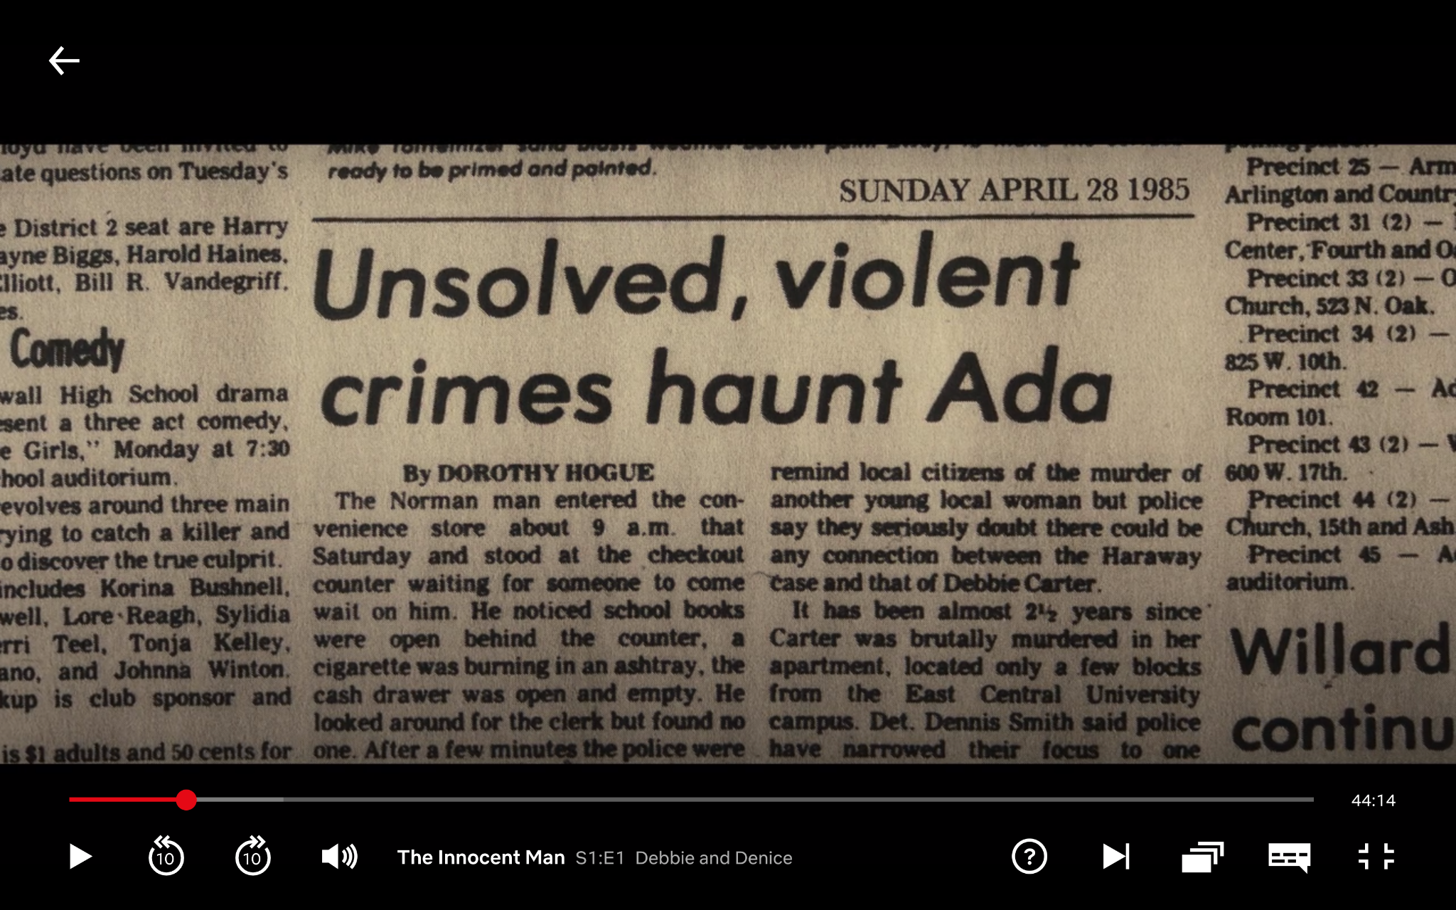
Commercial break

Slide 28
Data collection
Data labeling
Discretization?
N
Identification of features
Y
Y
Unsupervised/ supervised discretization
Class label available?
N
Removing irrelevant features
Standardization etc.
Y
Normalization?
N

Slide 29
Feature normalization
Some classifiers can’t easily handle features with very different scales, e.g.,
Revenue in CHF: 10,000,000
# of employees: 300
Features with large values dominate the others, and the classifier tends to over-optimize for them
Even single feature may span many orders of magnitude
e.g., city size (most cities small, some huge)
Too little resolution where data is dense, too much resolution where data is sparse
Notes:
Not a problem for some models with a unique solution (e.g., linear regression), but a problem for more complex models with many params optimized via gradient descent

Slide 30
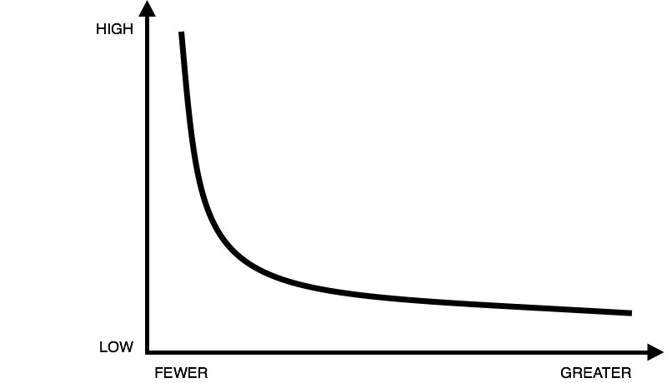
Logarithmic scaling
x_{i}’ = log(x_{i})
Consider order of magnitude, rather than direct value
Good for heavy-tailed features (e.g., from power laws)

Slide 31
Min-max scaling
x_{i}’ = (x_{i} – m_{i})/(M_{i} – m_{i})
where M_{i} and m_{i} are the max and min values of feature x_{i} respectively
The new feature x_{i}’ lies in the interval [0,1]

Slide 32
Standardization
x_{i}’ = (x_{i} – μ_{i})/σ_{i}
where μ_{i} is the mean value of feature x_{i}, and σ_{i} is the standard deviation
The new feature x_{i}’ has mean 0 and standard deviation 1
Notes:
We’ve already seen standardization when discussing linear regression (lec 5)

Slide 33
Dangers of standardization and scaling
Standardization:
Assume that the data has been generated by a Gaussian
Uses mean and std → not meaningful for heavy-tailed data (may be mitigated by log-scaling)
Min-max scaling:
If the data has outliers, they scale the typical values to a very small interval
Notes:
Both are best for features that are symmetrically centered around the mean
No “best” option
Domain expertise
Exploratory analysis
Try multiple things

Slide 34
Classification pipeline
Data collection
Model selection
Model assessment
Notes:
NB: when doing online feature selection, data collection and model selection are interleaved...

Slide 35
Model selection: high level
Need to choose type of model
k-NN?
Decision trees?
Random forest?
Boosted decision trees?
Logistic regression?
Deep learning?
…

Slide 36
Model selection: low level
Usually a classifier has some “hyperparameters” to be tuned
Set of features to include
Distance function (e.g., k-NN)
Number of neighbors (e.g., k-NN)
Number of trees (e.g., random forest)
Decision threshold (e.g., logistic regression)
Regularization parameter
Learning rate (for gradient descent algorithms)
Notes:
Parameters: tuned during training (“inner loop”)
Hyperparameters: need to be set before training can begin (“outer loop”)

Slide 37
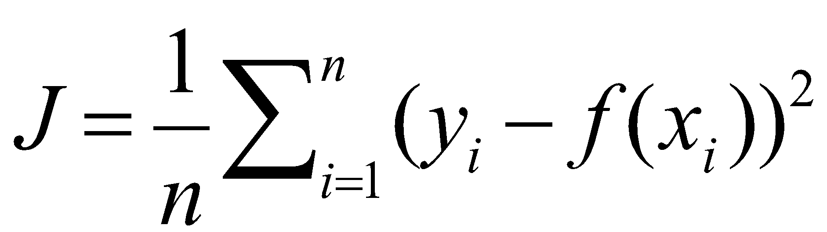
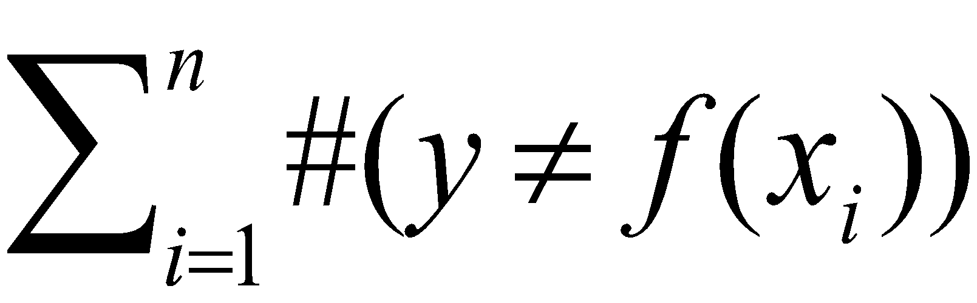
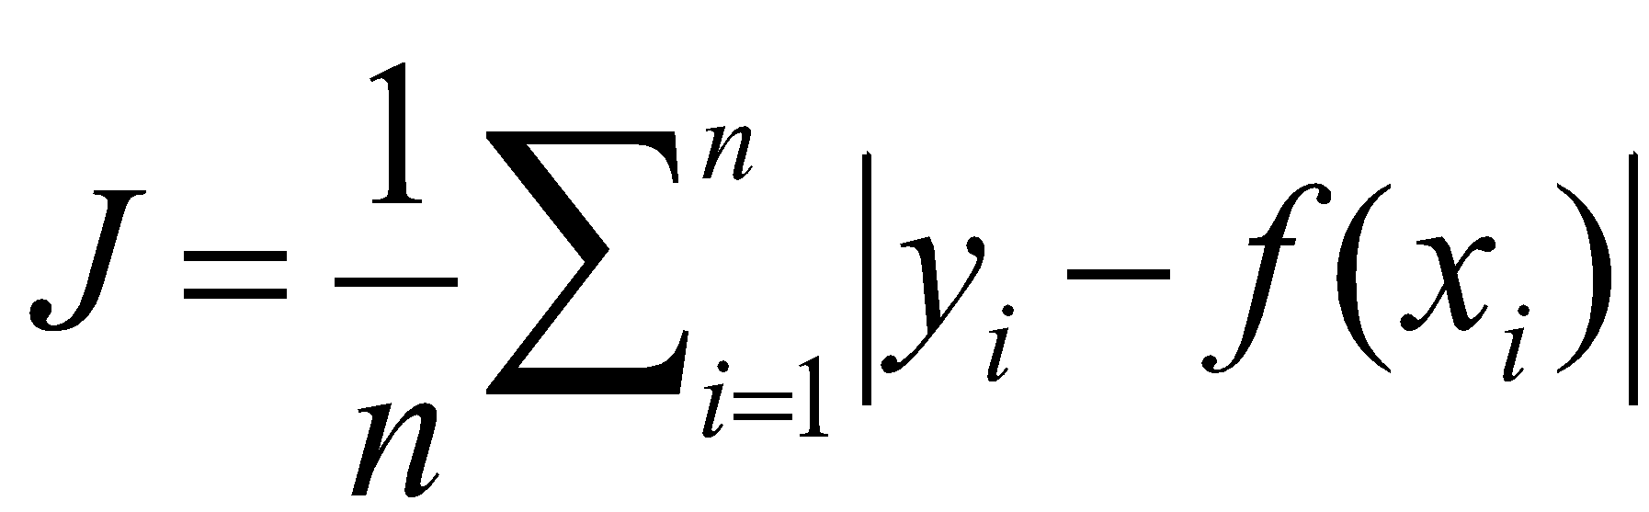
Loss function (more of them later!)
Categorical output
e.g., 0-1 loss function, risk (= 1 minus accuracy):
Real-valued output
e.g., squared error:
e.g., absolute error:
Notes:
For model selection: need to be able to quantify how good a model is
Often the function minimized via learning, but not necessarily (ideal loss function might be computationally hard to optimize)
…

Slide 38

Model selection: on what data to evaluate?
Full dataset
Training set
Testing set
Validation set
What if you can’t afford a 3-way split because you have too little data?
→ Cross-validation! (p.t.o.)
Notes:
Not allowed to use training set: overfitting (you have already used it for training)
Not allowed to use testing set: overfitting (you will see it again later for testing)
testing data only for final perf number, not for identifying best model
You lock it away in a safe, put the key in a glass of water, put it in the freezer, do model selection, put the training/valid data in another safe, throw the key for that second safe into Lake Geneva, and only then you take your frozen glass back out and unlock the test data

Slide 39
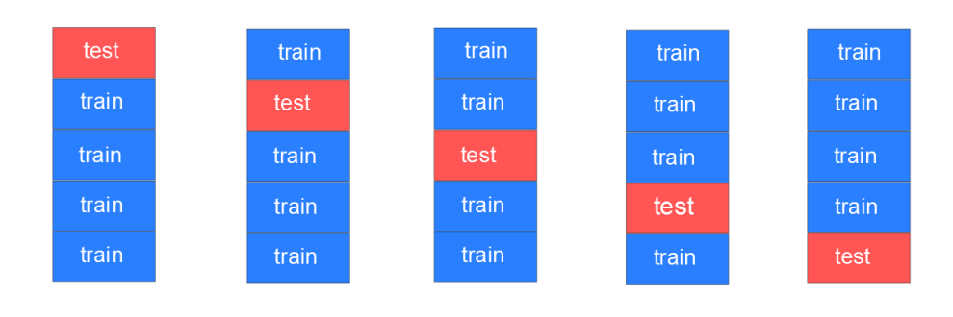
Cross-validation
Last lecture: leave-one-out cross-validation == N-fold cross-validation (where N is #data points)
More efficient: m-fold cross-validation (in above picture: m = 5)
Average performance over the m red portions → validation error
Repeat procedure for all candidate models and pick the one with the lowest validation error
Notes:
The entire stack is the full training data
“Test” means not the held-out test set (it’s still locked away in the safe!), but a test portion of the training set
Why do this? → avoid overfitting
Explain how to choose number of neighbors in k-NN with CV

Slide 40
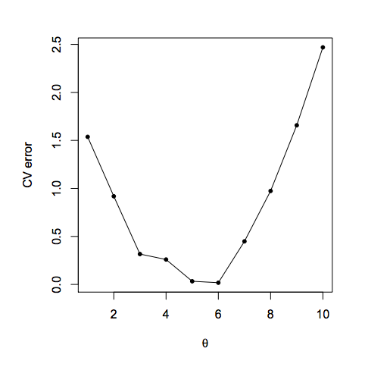
Model selection
Validation error
Hyperparameter value
Notes:
X-axis e.g. number of neighbors in k-NN

Slide 41
Performance metrics for binary classification
For categorical binary classification, the usual metrics are based on the confusion matrix, which has 4 values:
True Positives (positive examples classified as positive)
True Negatives (negative examples classified as negative)
False Positives (negative examples classified as positive)
False Negatives (positive examples classified as negative)
 |  | Class
 |  | Pos | Neg
Classified | Pos | TP | FP
 | Neg | FN | TN

Slide 42
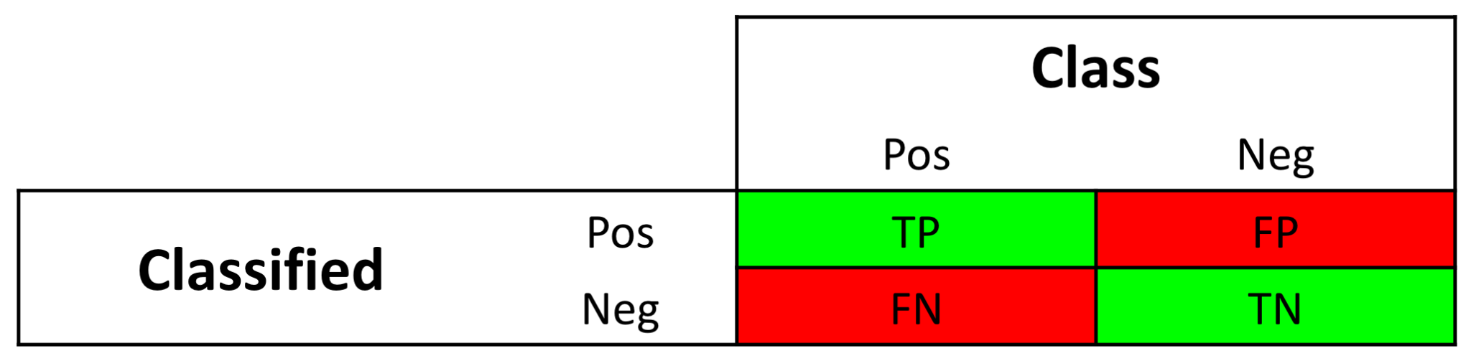
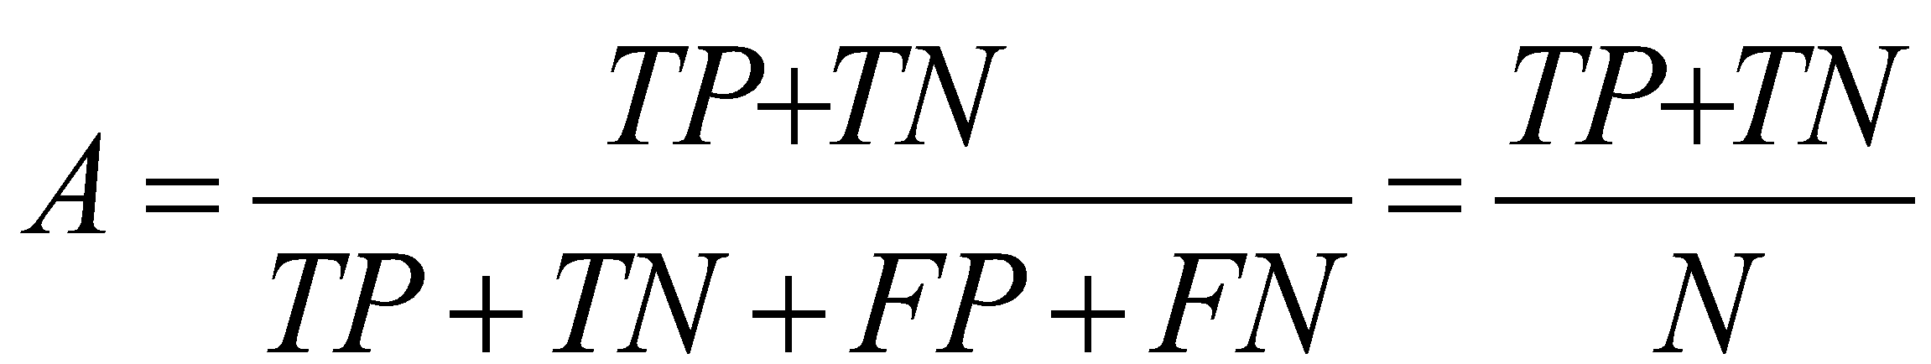
Accuracy
Appropriate metric when
classes are not skewed
errors (FP, FN) have the same importance
Notes:
Fraction of green

Slide 43
Accuracy (skewed example)
Classifier 1 |  | Class
 |  | Fraud | ¬Fraud
Classified | Fraud | 5 | 10
 | ¬Fraud | 5 | 80
Accuracy = 85/100 = 85%
Accuracy = 90/100 = 90%
Always ¬Fraud |  | Class
 |  | Fraud | ¬Fraud
Classified | Fraud | 0 | 0
 | ¬Fraud | 10 | 90
Notes:
Fraud is a rare event

Slide 44

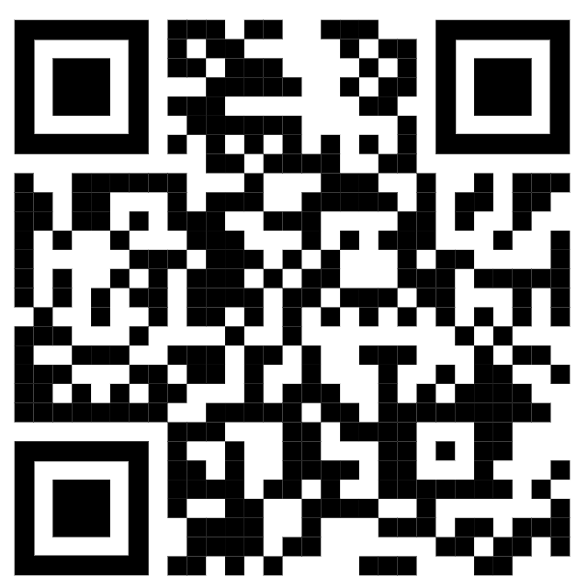
Question time
Classifier 1 |  | Class
 |  | A | B
Classified | A | 45 | 20
 | B | 5 | 30
100 data points
Which classifier is better?
Classifier 1
Classifier 2
Both are equally good
Classifier 2 |  | Class
 |  | A | B
Classified | A | 40 | 10
 | B | 10 | 40
100 data points
POLLING TIME
Scan QR code or go to https://web.speakup.info/room/join/66626
Notes:
(Given tight timing, probably better to skip poll, and just ask into room.)
================
Which classifier is better?
(A) Classifier 1
(B) Classifier 2
(C) Both are equally good

Slide 45
Question time
Classifier 1 |  | Class
 |  | Cancer | ¬Cancer
Classified | Cancer | 45 | 20
 | ¬Cancer | 5 | 30
Classifier 2 |  | Class
 |  | Cancer | ¬Cancer
Classified | Cancer | 40 | 10
 | ¬Cancer | 10 | 40
Which classifier is better?
Classifier 1
Classifier 2
Both are equally good
Notes:
Abstract classes A, B now concrete: A = cancer, B = not cancer
Left classifier: fewer cancers not recognized → better (goal is to recognize cancer)
To formalize this, we need to define further perf metrics beyond plain accuracy, which brings us to … (p.t.o.)

Slide 46

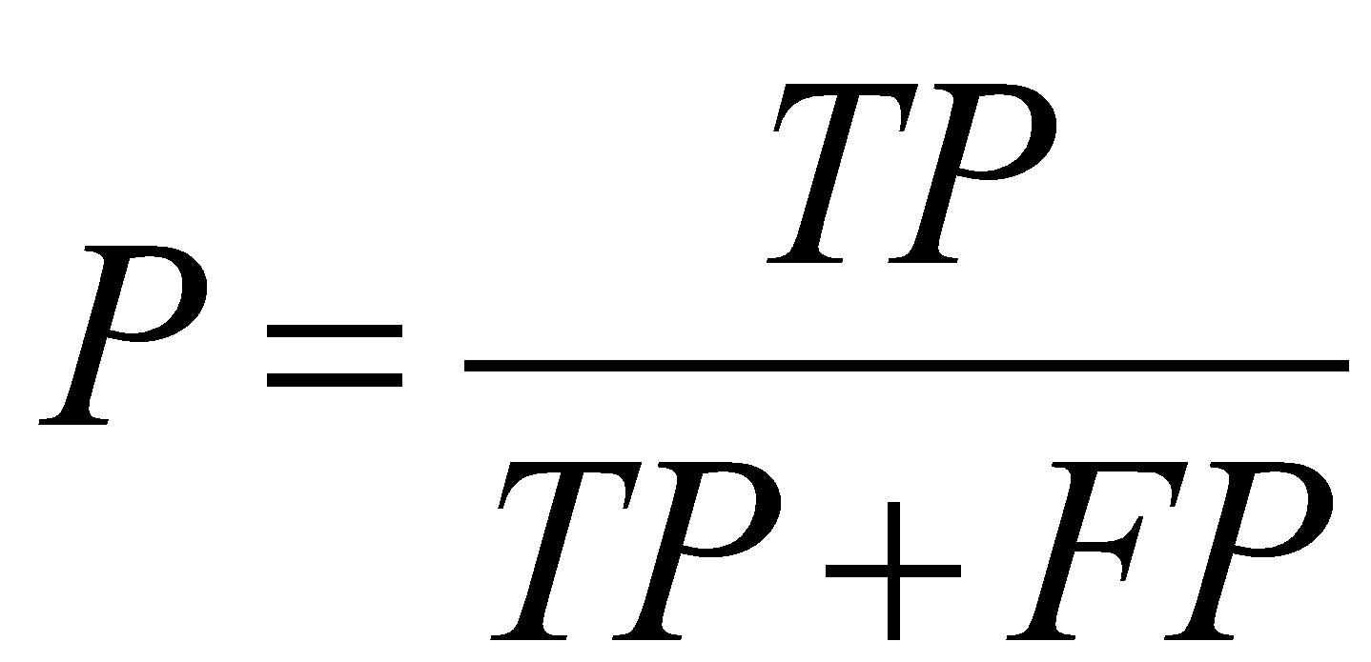
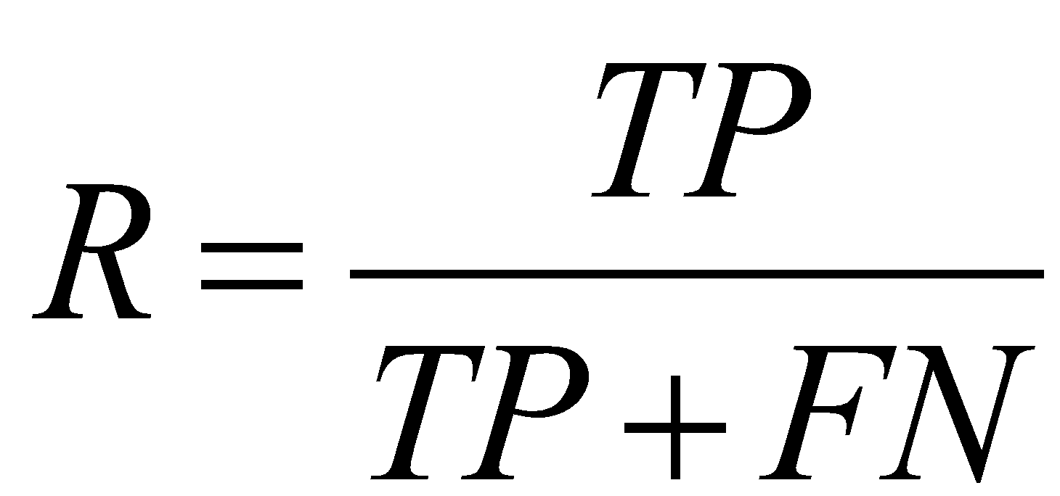
Precision and recall
Precision: what fraction of positive predictions are actually positive?
Recall: what fraction of actually positive examples did I recognize as such?
[source]
Notes:
Cancer example
Can also define this for negative class
Need to internalize these notions until they’re fully intuitive to you!
NB: the notion of precision described here (also see https://en.wikipedia.org/wiki/Precision_and_recall) is different from that defined in this other wiki article: https://en.wikipedia.org/w/index.php?title=Accuracy_and_precision&oldid=1054342391#In_binary_classification

Slide 47
Precision and recall
P₁=45/65=0.69 P₂=40/50=0.8
R₁=45/50=0.9 R₂=40/50=0.8
Classifier 1 |  | Class
 |  | Cancer | ¬Cancer
Classified | Cancer | 45 | 20
 | ¬Cancer | 5 | 30
Classifier 2 |  | Class
 |  | Cancer | ¬Cancer
Classified | Cancer | 40 | 10
 | ¬Cancer | 10 | 40
Everybody has cancer |  | Class
 |  | Cancer | ¬Cancer
Classified | Cancer | 50 | 50
 | ¬Cancer | 0 | 0
P = 50/100 = 0.5
R = 50/50 = 1
Notes:
Classifier 2 is more precise at hitting the cancer (few patients erroneously diagnosed with cancer)
Classifier 1 has a better recall, few patients with cancer are not diagnosed correctly
Increasing recall is easy. The classifier Everybody Has Cancer of course detects all the patients with cancer, but also causes 50% of the patients with no cancer to go home worried about their health status

Slide 48
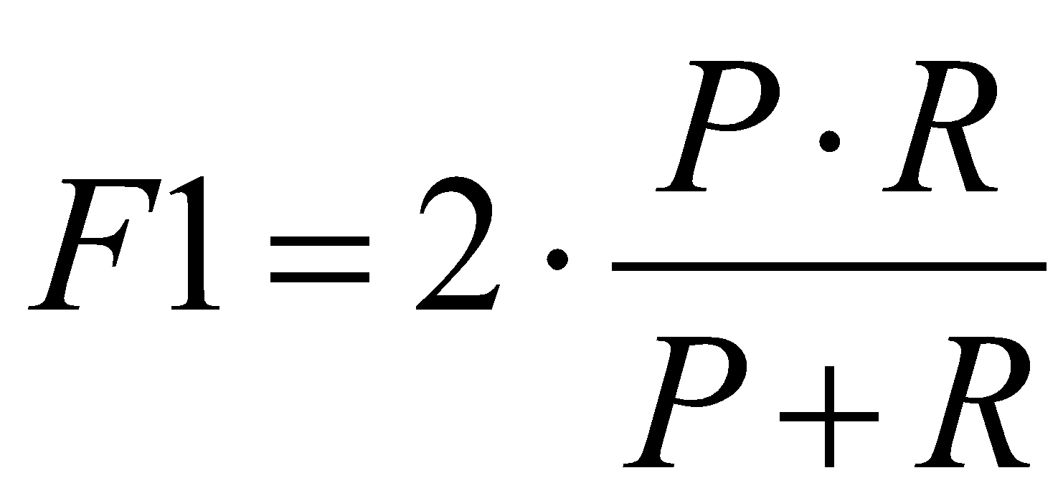
F-score
Sometimes it’s necessary to have a single metric to compare classifiers
F-score (or F1-score): harmonic mean of precision and recall
Precision and recall can be differently weighted, if one is more important than the other
F1 = 1 / (0.5 * (1/P + 1/R)) =
Notes:
(...)
Different importance:
cancer (recall over precision)
spam filter (precision over recall)
“Who knows what harmonic mean is?” (you should know from lec 4)
Generally the right kind of mean when averaging quantities w/ identical numerator (rather than denominator)
Example:
Train: first 100km/h, then 200km/h; 1h at each speed (i.e., fixed denominator): avg = 150km/h (arithmetic); 1km at each speed (i.e., fixed numerator): avg = 133km/h (harmonic)
Another, practical desirable property: 0 as soon as one of P or R 0 (not the case for arithmetic mean)
Generally, whenever possible, don’t only report F-score, also report P and R

Slide 49
Precision and recall
F₁=2*(0.69*0.9)/(0.69+0.9) F₂=2*(0.8*0.8)/(0.8+0.8)
= 0.78 =0.8
Classifier 1 |  | Class
 |  | Cancer | ¬Cancer
Classified | Cancer | 45 | 20
 | ¬Cancer | 5 | 30
Classifier 2 |  | Class
 |  | Cancer | ¬Cancer
Classified | Cancer | 40 | 10
 | ¬Cancer | 10 | 40
Everybody has cancer |  | Class
 |  | Cancer | ¬Cancer
Classified | Cancer | 50 | 50
 | ¬Cancer | 0 | 0
F=2*(0.5*1)/(0.5+1)=0.66

Slide 50
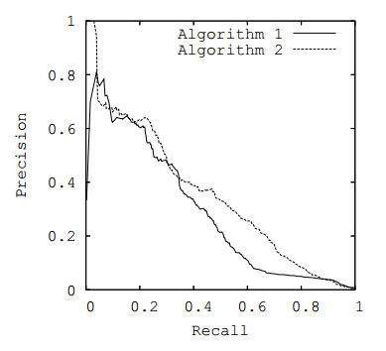
Precision/recall curve
Decreasing classification threshold
Notes:
Which algo is better?
What would perfect predictor look like?

Slide 51
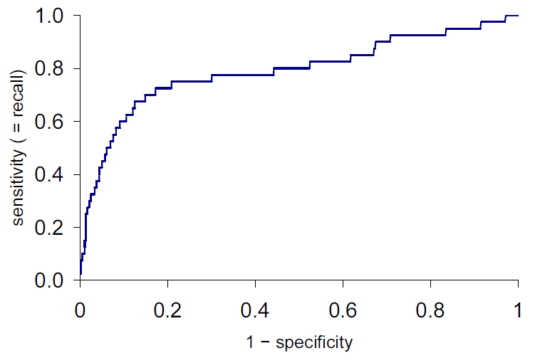
ROC curve
ROC = Receiver-Operating Characteristic (WTF?!)
Y-axis: true-positive rate = TP/(TP + FN), a.k.a. recall
X-axis: false-positive rate = FP/(FP + TN)
True-positive rate
Decreasing classification threshold
False-positive rate
Notes:
Question: What will ROC curve look like for a
perfect classifier?
random classifier?

Slide 52
ROC AUC
ROC AUC is the “area under the curve” – a single number that captures the overall quality of the classifier. It should be between 0.5 (random classifier) and 1.0 (perfect).
True-positive rate
Random ordering
area = 0.5
False-positive rate
Notes:
Interpretation: for what fraction of pos/neg pairs does pos receive a higher score?
[Or: What fraction of all negs is ranked below pos on avg (avg over all positives)?]
Advantage: ROC AUC not dependent on choice of threshold! (unlike accuracy, precision, recall, etc.)

Slide 53
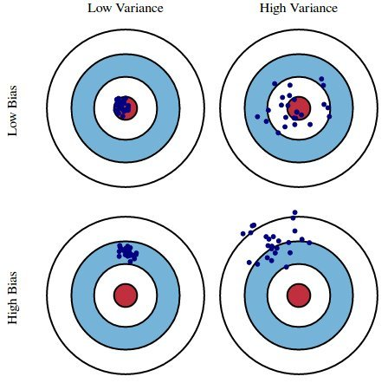
Bias and variance
[lecture 7]
Notes:
Train model with different training sets; evaluate them all on same test point

Slide 54
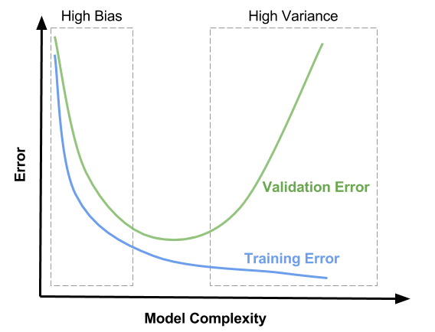

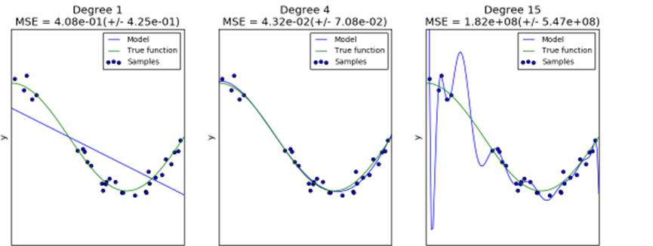
How to know where on the x-axis you are (without fiddling with model complexity)?
Validation Error
Notes:
“Model complexity”: e.g., degree of polynomial (bottom row)
You don’t measure bias/variance directly (would require sampling many different training sets and retraining every time), but you look at error on train vs. validation set
[left] high bias, low variance → underfitting → high training error and high test error (model is too simple to fit training data)
[right] high variance, low bias → overfitting → low training error but high test error (model too complex for amount of data)
https://zahidhasan.github.io/2020/10/13/bias-variance-trade-off-and-learning-curve.html

Slide 55
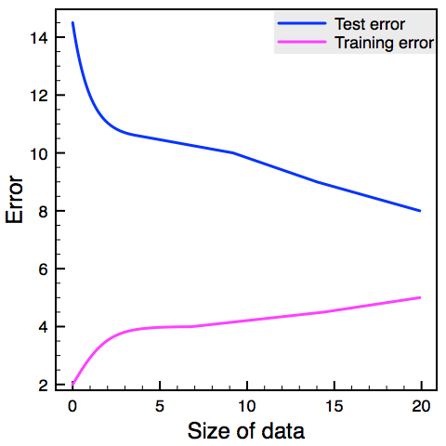
Bias and variance
Bias and variance can be assessed by comparing the error metric on the training set and the validation set => always plot learning curves (training set size vs. training/validation errors)
Validation error
Training error

Slide 56
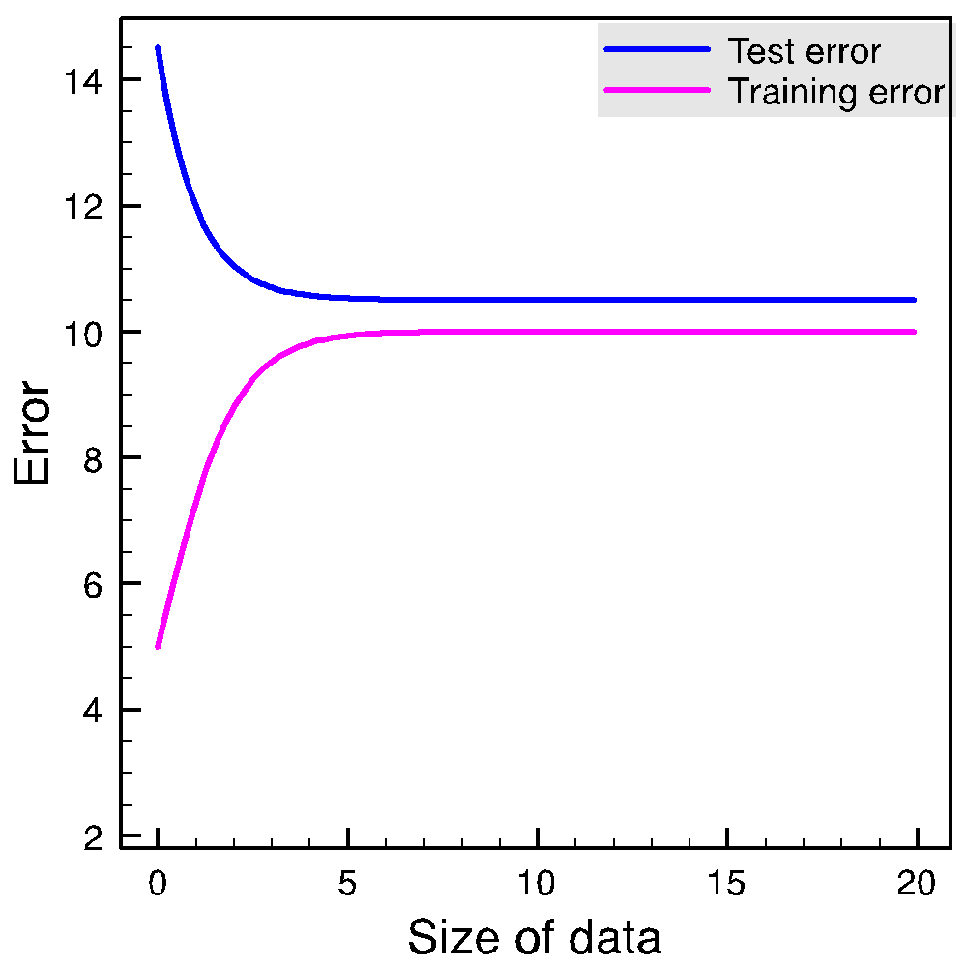
When more data helps
Fixed data set size Varying model complexity
Validation error
Validation error
Training error
Fixed model complexity Varying data set size
Training error
For curious ADAventurers: “Reconciling modern machine-learning practice and the classical bias–variance trade-off”
https://www.pnas.org/doi/abs/10.1073/pnas.1903070116
High bias
More data doesn’t help
High variance
More data helps
Notes:
More data (going right on learning curves) → validation error decreases (can learn more accurate model when seeing more data); training error increases (more data is harder to fit; e.g., higher chance of >=1 extreme outlier)
Also: more data → variance decreases (if training set is large, seeing different training set makes less of a difference)
When bias is high (underfitting), more data does not help (problem is weak model, not little data). When variance is high (overfitting), more data may help.
High variance: high model capacity → just need to feed the monkey
Need to be able to read these plots (the tea leaves)
Good strategy: first overfit like hell, then add more data and/or gradually decrease model complexity

Slide 57
Classification pipeline
Data collection
Model selection
Model assessment

Slide 58
Model assessment
Model assessment is the goal of estimating the performance of a fixed model (i.e., the best model found during model selection)
Ideally under real-world conditions
Use held-out test set that you’ve never seen during training
Notes:
Ideally, don’t touch test set before you write paper / sell your model (can’t go back to change model)

Slide 59
Useful reads

Slide 60
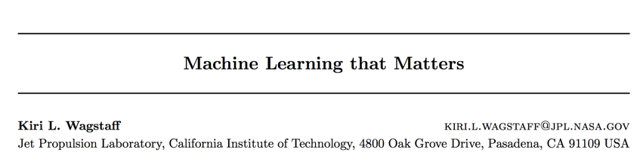
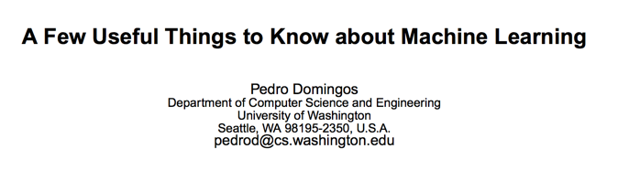
slides

Slide 61
Feedback
Give us feedback on this lecture here: https://go.epfl.ch/ada2023-lec8-feedback
What did you (not) like about this lecture?
What was (not) well explained?
On what would you like more (fewer) details?
…

Slide 62
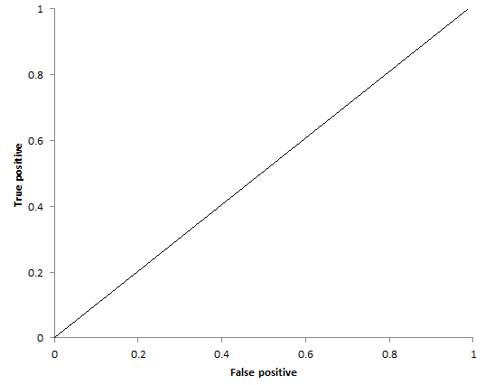
Crowdsourcing
Different types of workers
Truthful
Expert
Normal
Untruthful
Uniform spammer
Random spammer
Malicious spammer (a.k.a. a$s#*le)
Uniform
Spammer
Expert
Normal
Worker
True positive rate
Random Spammer
Malicious
Spammer
Uniform
Spammer
True negative rate
Notes:
(explain axes: fraction of pos/neg points labeled correctly)
Not all the workers are equally good
Sloppy Worker: give many wrong answers due to their knowledge limitations or misunderstanding
Random Spammer: give random answers for any question.
Uniform Spammer: keep the same answer for every question.

Slide 63
Catching malicious spammers
Insert obvious examples for which you already know the labels (“honeypot”)
Tell workers they won’t be paid if they don’t get those right
Filter out workers who don’t get them right
Aggregate multiple answers
p.t.o.
Notes:
Useful even if there’s really no honeypot, or if you still pay everyone

Slide 64
Crowdsourcing
Answer aggregation problem
Have each example labeled by several workers, aggregate:
e.g., majority vote (works if only a minority is malicious)
e.g., “peer prediction”, “prediction markets” (game theory: workers are paid more if they agree with others)
Worker | Webpage | Credible
W₁ | www.diet.com | C
W₂ | www.diet.com | ¬C
W₃ | www.diet.com | C
... | ... | ...
Aggregation
Crowd (workers)
www.diet.com | C
Notes:
Can give different weights to different workers
Agree with others?
Get honeypot questions right?
Also the idea behind peer prediction: game-theoretic approach to defining payoffs based on agreement with others

Slide 65
Recap
Data collection
Model selection
Model assessment
Model selection:
Use training data in cross-validation
Need evaluation metric
Typically based on confusion matrix
e.g., accuracy, precision, recall
 |  | Class
 |  | A | B
Classified | A | TP | FP
 | B | FN | TN

Slide 66
Model selection
Need evaluation metric!
Split dataset into “training” and “validation”
Set classifier parameters
Train classifier with training set
Evaluate classifier with validation set
Performance acceptable?
N
Y
Notes:
Dataset = dataset you’re allowed to see during training
May do several times for same parameter value → cross validation
Alternative: sweep over all possible param values exhaustively

Slide 67
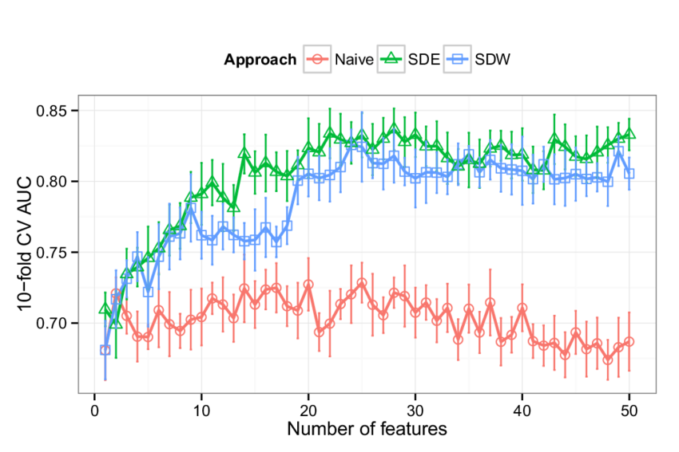
Fwd-selected features vs. performance

Slide 68
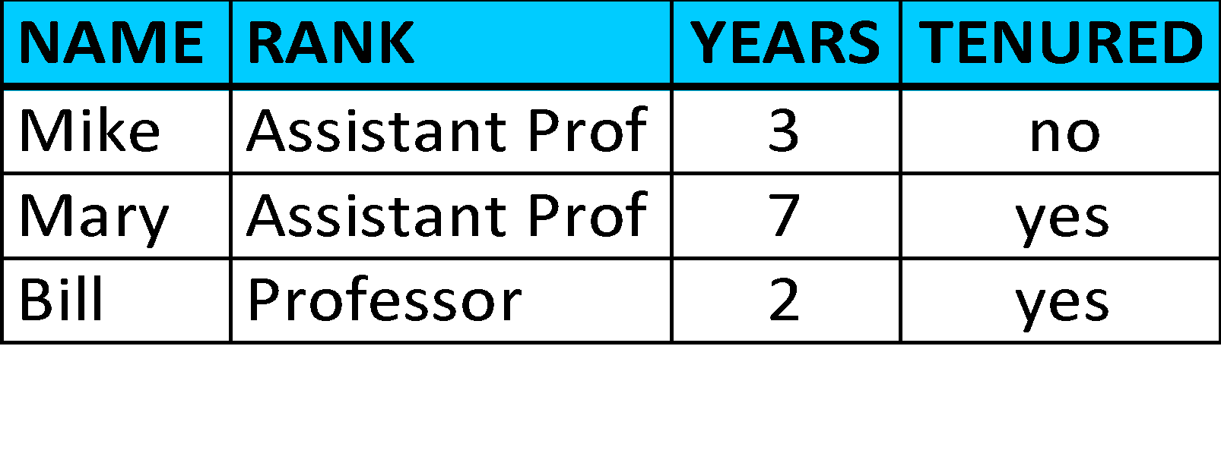


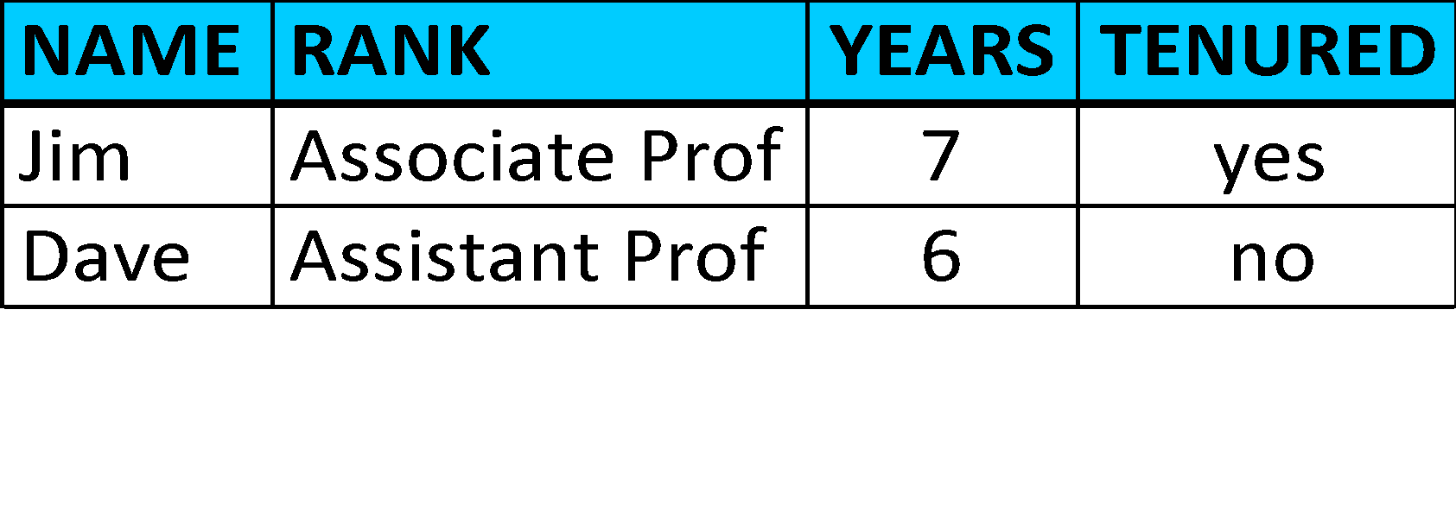
Training and testing with heaps of data
learn model
60% of D
training set
database D
40% of D
evaluate model
test set
performance metric

Slide 69
Data-efficient training and testing:
Leave-one-out cross-validation
(N-1)/N of D
learn model
training set
database D
1/N of D
evaluate model
test set
Repeat N times
average of N runs
Notes:
Leave-one-out is almost unbiased (=not optimistic) estimate of the true accuracy; however, it is time consuming because it performs a number of iterations equal to the number of examples in the dataset

Slide 70
Data-efficient training and testing:
k-fold cross validation
learn model
(k-1)/k of D
training set
database D
1/k of D
evaluate model
test set
Repeat k times
average of k runs
Notes:
K-fold cross-validation is a good compromise between having an unbiased estimate of the true accuracy and computation time

Slide 71
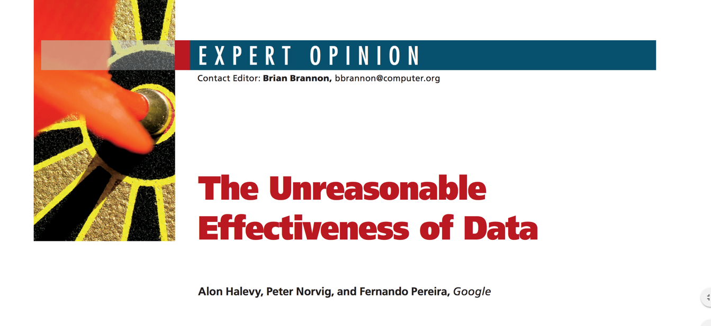
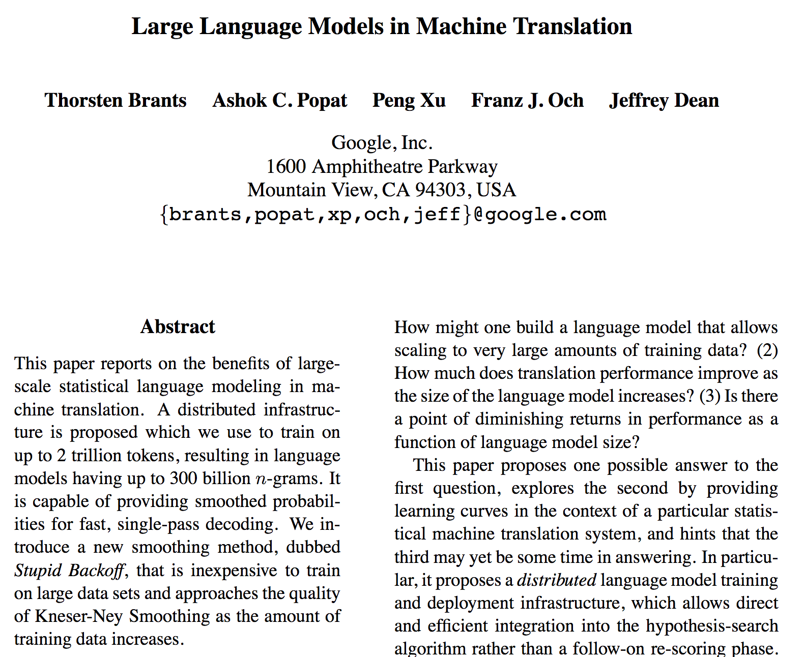
More data often beats better algorithms
Notes:
(from lecture 1)
Modern NN models with many (billions of params) have high variance. Often good things happen when you have tons of data.

